Slide 1

QER - 4469
QER: BID 141KM SF300065C004.3X - Zeta wire weld crack

Slide 2
Pipe section / Details
Item | Traceability / identification
Project number | SF300065C004
Project name | BID 141KM
Pipe section | SF300065C004.3X
ST number | ST101.51896
Affected layer / equipment | Spiralling
Length affected | 1) 940m 2) 5182.9m
Drawing number / MP code / STA / Dimension | Zeta wire 6.2 (MP205)

Slide 3
Overview of anomaly
Problem Description :-
During the zeta spiraling process for BID 141KM SF300065C004.3X (ST10151896), the weld cracks were detected at lengths 940m and 5182.9m during weld inspection after it was laid on the pipe.
Note that, this affected weld is weld from the winding process.
Details of the defective weld are as the following: -
1. Length on the pipe: 940m
Weld No: 8-7
Bobbin no: 005
2. Length on the pipe: 5182.9mm
Weld No: 49-07
Bobbin no: 007
Root Cause :-
The root cause to be Investigated
Problem Handling:-
The defective weld was rejected according to DP-QCP-08DAQT001. Therefore, un-spiraling was performed to remove the defective weld and replaced it with a new weld as per DI-IND-MET1075.
In addition, based on DI-IND-MET1075, the subsequent welds shall be retrieved if reachable for the test and analysis. The subsequent welds were gone through the tensile test.

Slide 4
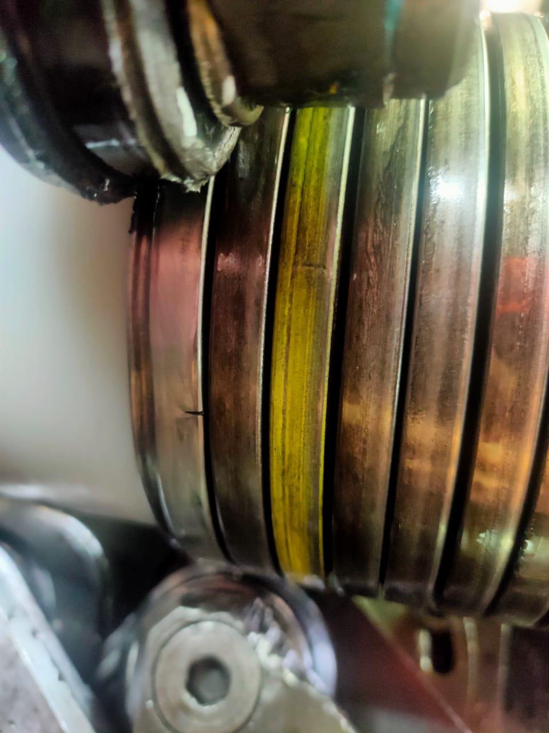
Wire crack length 940m photo
Figure 1 : Weld crack was detected at length 940m during weld inspection after it was laid on the pipe..

Slide 5
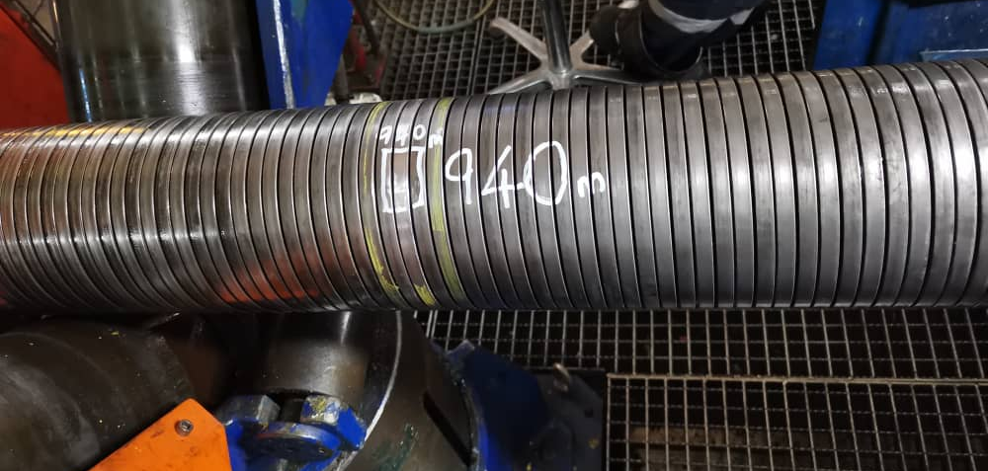
Repaired 940m Photo
Figure 2 : Replaced with weld 03-04 from (BS13-12)

Slide 6
Zeta wire weld crack at length 5182.9m
Figure 3 : Weld crack was detected at length 5182.9m during weld inspection after it was laid on the pipe.

Slide 7
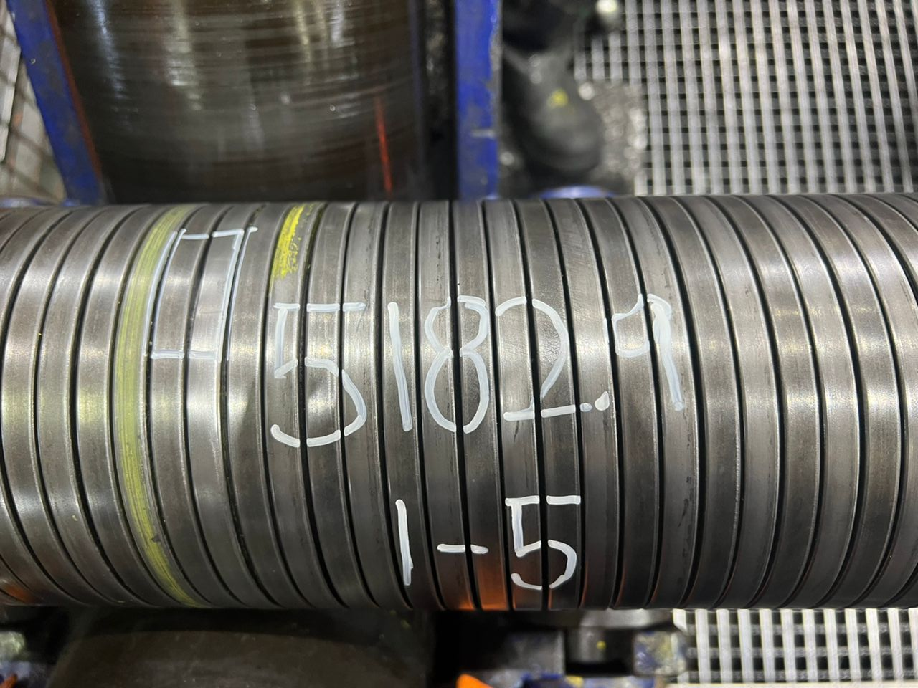
Photo after repaired
Figure 4 : Replaced with weld 01-05 from (BS13-12)

Slide 8
Subsequent weld result
In addition, based on DI-IND-MET1075, the subsequent welds shall be retrieved if reachable for the test and analysis. The subsequent welds were gone through the tensile test, and the result is detailed below.
1. Length on the pipe: 940m
Weld No: 8-7
Bobbin no: 005
Tensile results for the subsequent welds:-
- Weld 14-07 (N+6) : 579mPa
- Weld 13-07 (N+5) : 586mPa
- Weld 12-07 (N+4) : 563.3mPa
2. Length on the pipe: 5182.9mm
Weld No: 49-07
Bobbin no: 007
Tensile results for the subsequent welds: -
- Weld 48-07 (N-1) : 576.4mPa
- Weld 50-07 (N+1) : 597.7mPa
The minimum criteria for the tensile test are 530mPa.

Slide 9

THANK YOU

